Slide 1
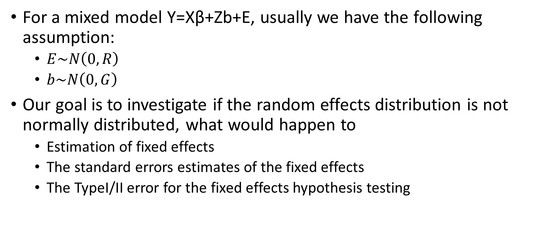
Project2: Overview of goal Zhou,Wenru Group3 members: Zhang, Lingdi; Zhuang, Yaxu; Zhou, Wenru
For a mixed model Y=Xβ+Zb+E, usually we have the following assumption:
$E\sim N\left(0,R\right)$
$b\sim N\left(0,G\right)$
Our goal is to investigate if the random effects distribution is not normally distributed, what would happen to
Estimation of fixed effects
The standard errors estimates of the fixed effects
The TypeI/II error for the fixed effects hypothesis testing

Slide 2
The case we would study
Dataset:
Number of subjects =20 with 5 and 10 observations per subject.
Number of subjects =200 with 5 and 10 observations per subject.
Number of subjects =1000 with 5 and 10 observations per subject.
Number of dataset in each case is 500.
Model:
Random intercept
Random intercept and slope models.
Fixed components :
Treatment, which indicates treatment or no treatment
Time, which goes from 0 to 4 as integers or 0 to 9 as integers
An interaction between time and treatment should be put into the simulation model
Random components and error distribution:
Error: a independent model error structure.
Random components: a skewed distribution and a mixture distribution.

Slide 3
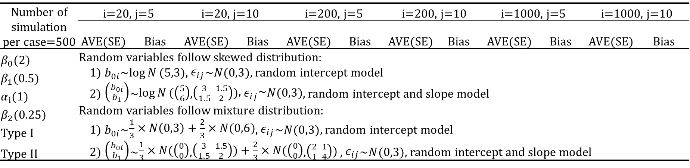
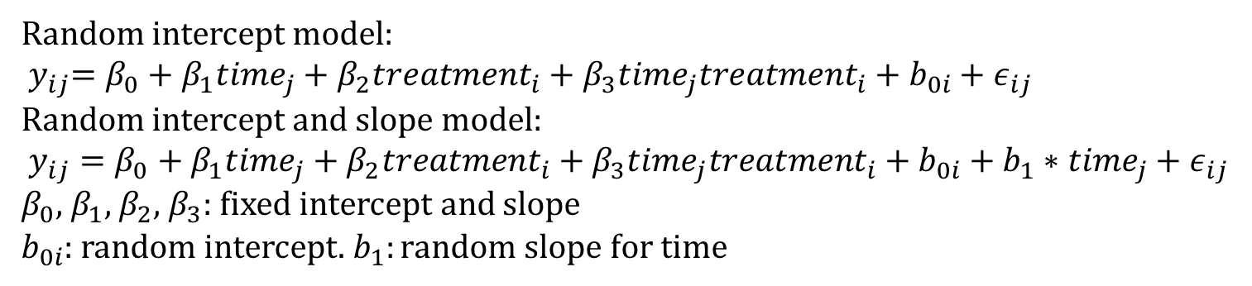
The parameters in the simulation
Random intercept model:
$${ y}_{ij}=β_{0}+β_{1}{time}_{j}+β_{2}{treatment}_{i}+β_{3}{time}_{j}{treatment}_{i}+b_{0i}+ε_{ij}$$
Random intercept and slope model:
$y_{ij}=β_{0}+β_{1}{time}_{j}+β_{2}{treatment}_{i}+β_{3}{time}_{j}{treatment}_{i}+b_{0i}+b_{1}∗{time}_{j}+ε_{ij}$
$β_{0}$, $β_{1}$, $β_{2}$, $β_{3}$: fixed intercept and slope
$b_{0i}$: random intercept. $b_{1}:random slope for time$
Number of simulation per case=500 | i=20, j=5 |  | i=20, j=10 |  |  | i=200, j=5 |  |  | i=200, j=10 |  | i=1000, j=5 |  | i=1000, j=10
 | AVE(SE) | Bias |  | AVE(SE) | Bias |  | AVE(SE) | Bias | AVE(SE) | Bias | AVE(SE) | Bias | AVE(SE) | Bias
$β_{0}$(2) | Random variables follow skewed distribution: 1) $b_{0i}$~$\log{N}(5,3)$, $ε_{ij}$~$N(0,3)$, random intercept model 2) $\left({b_{0i} \atop b_{1}}\right)$~$\log{N}(\left({5 \atop 6}\right)$,$\left({3 \atop 1.5} {1.5 \atop 2}\right))\text{, }ε_{ij}\text{\sim }N(0,3)$, random intercept and slope model Random variables follow mixture distribution: 1) $b_{0i}$~$\frac{1}{3}×N\left(0,3\right)+\frac{2}{3}×N(0,6)$, $ε_{ij}$~$N(0,3)$, random intercept model 2) $\left({b_{0i} \atop b_{1}}\right)$~$\frac{1}{3}×N(\left({0 \atop 0}\right)$,$\left({3 \atop 1.5} {1.5 \atop 2}\right))+\frac{2}{3}×N(\left({0 \atop 0}\right)$,$\left({2 \atop 1} {1 \atop 4}\right))$ , $ε_{ij}$~$N(0,3)$, random intercept and slope model
$β_{1}$(0.5)
$α_{i}$(1)
$β_{2}$(0.25)
Type I
Type II
We will evaluate the output by comparing the true values and the estimated values, SD and SE from mixed modeling

